Slide 1
Lecture-1: Recurrent Basics
Tanvir Ahammad
Lecturer
Dept. of CSE
Jagannath University, Bangladesh

Slide 2
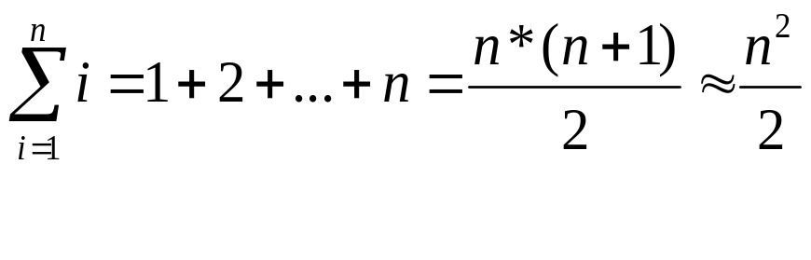
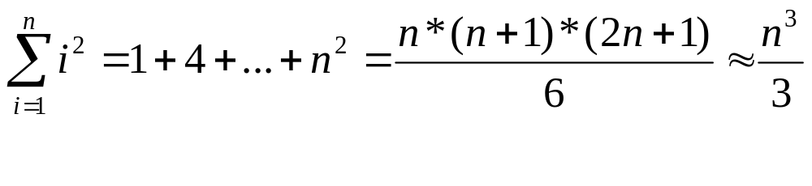
Some Mathematical Facts
Some mathematical equalities are:
Courtesy: Md. Manowarul Islam

Slide 3
Analyzing Recursive Algorithms
Often a recurrence equation is used as the starting point to analyze a recursive algorithm
  In the recurrence equation, T(n) denotes the running time of the recursive algorithm for an input of size n
A(n)
{
if(condition)
Return (A(n/2)+A(n/2))
}
Assume:
Total time is T(n)
The if takes constant time c.
T(n) = c + 2T(n/2)
Courtesy: Md. Manowarul Islam

Slide 4
Analyzing Recursive Algorithms
Let consider the following algorithm:
A(n)
{
if(n>1)
Return (A(n-1))
}
Assume:
Total time is T(n)
The if takes constant time 1.
T(n) = 1 + T(n-1) ------------------(1)
T(n-1) = 1 + T(n-2) -----------------(2)
T(n-2) = 1 + T(n-3) -----------------(3)
Courtesy: Md. Manowarul Islam

Slide 5
Analyzing Recursive Algorithms
Let consider the following algorithm:
A(n)
{
if(n>1)
Return (A(n-1))
}
T(n) = 1 + T(n-1) ---------------(1)
T(n-1) = 1 + T(n-2) -------------(2)
T(n-2) = 1 + T(n-3) ------------(3)
From equation 1:
T(n) = 1 + T(n-1)=1 +1+ T(n-2)=2+T(n-2)
T(n) = 2 + T(n-2)=2+ 1+T(n-3)=3+T(n-3)
T(n) = …………….
=k+T(n-k)
Then when it will stop??????????????
Courtesy: Md. Manowarul Islam

Slide 6
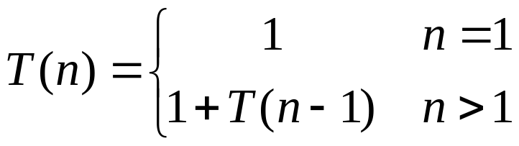
Analyzing Recursive Algorithms
Let consider the following algorithm:
A(n)
{
if(n>1)
Return (A(n-1))
}
From equation 1:
T(n) = 1 + T(n-1)=1 +1+ T(n-2)=2+T(n-2)
T(n) = 2 + T(n-2)=2+ 1+T(n-3)=3+T(n-3)
T(n) = …………….
=k+T(n-k)
So we can write we will stop if:
n-k=1
That is k=n-1
Courtesy: Md. Manowarul Islam

Slide 7

Analyzing Recursive Algorithms
Let consider the following algorithm:
A(n)
{
if(n>1)
Return (A(n-1))
}
From equation 1:
T(n) = 1 + T(n-1)=1 +1+ T(n-2)=2+T(n-2)
T(n) = 2 + T(n-2)=2+ 1+T(n-3)=3+T(n-3)
T(n) = …………….
=k+T(n-k)
…………..
= (n-1)+T(n-(n-1))
= n-1+T(1)
= n-1+1
= n
k=n-1
T(n) = n =O(n)
Courtesy: Md. Manowarul Islam

Slide 8
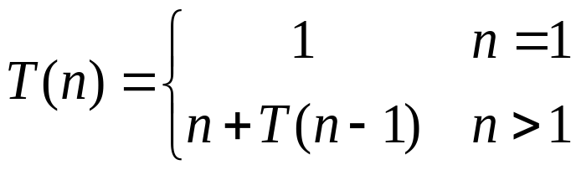
Analyzing Recursive Algorithms
Let consider the following
T(n) = n + T(n-1) ---------------(1)
T(n-1) = (n-1) + T(n-2) -------------(2)
T(n-2) = (n-2) + T(n-3) ------------(3)
From equation 1:
T(n) = n + T(n-1)
=n + (n-1) + T (n-2)
=n + (n-1) + (n-2) +T(n-3)
---------------
= n + (n-1) + (n-2) +… … …. (n-k)+T(n-(k+1))
Courtesy: Md. Manowarul Islam

Slide 9
Analyzing Recursive Algorithms
Let consider the following
From equation 1:
T(n) = n + T(n-1)
=n + (n-1) + T (n-2)
=n + (n-1) + (n-2) +T(n-3)
---------------
= n + (n-1) + (n-2) +… … …. (n-k)+T(n-(k+1))
We will stop if :
n-(k+1)=1
⇒k=n-2
T(n) = n + (n-1) + (n-2) +… … …. (n-n-2)+T(n-(n-2+1))
=n + (n-1) + (n-2) +… … …. +2+T(n-n+2-1))
=n + (n-1) + (n-2) +… … …. +2+T(1)
=n + (n-1) + (n-2) +… … …. +2+1
= n(n+1)/2=O(n²)
Courtesy: Md. Manowarul Islam

Slide 10
Recurrence Relations (1/2)
A recurrence relation is an equation which is defined in terms of itself with smaller value.
Why are recurrences good things?
  Many natural functions are easily expressed as recurrences:
    a_{n} = a _{n-1} + 1, a₁ = 1 −−> a_{n} = n (polynomial)
    a_{n} = 2a _{n-1} ,a₁ = 1 −−> a_{n} = 2^{n} (exponential)
    a_{n} = na _{n-1} ,a₁ = 1 −−> a_{n} = n! (weird function)
It is often easy to find a recurrence as the solution of a counting problem
Courtesy: Md. Manowarul Islam

Slide 11
Recurrence Relations (2/2)
In both, we have general and boundary conditions, with the general condition breaking the problem into smaller and smaller pieces.
The initial or boundary condition terminate the recursion.
Courtesy: Md. Manowarul Islam

Slide 12
Recurrence Equations
A recurrence equation defines a function, say T(n). The function is defined recursively, that is, the function T(.) appear in its definition. (recall recursive function call). The recurrence equation should have a base case.
For example:
T(n) = T(n-1)+T(n-2), if n>1
    1, if n=1 or n=0.
base case
for convenient, we sometime write the recurrence equation as:
T(n) = T(n-1)+T(n-2)
T(0) = T(1) = 1.
Courtesy: Md. Manowarul Islam

Slide 13



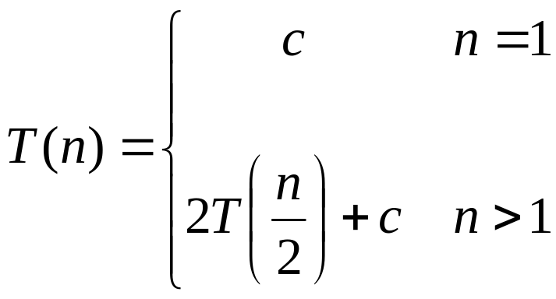
Recurrence Examples
Courtesy: Md. Manowarul Islam

Slide 14
Solving Recurrence Relations
the recurrence relation for the Fibonacci sequence is Fn=Fn−1+Fn−2. (This, together with the initial conditions F0=0 and F1=1 give the entire recursive definition for the sequence.)
  i.e., F(n)=0,1,1,2,3,5,8,13,…….
The recurrence relation tells you how to get from previous terms to future terms.

Slide 15
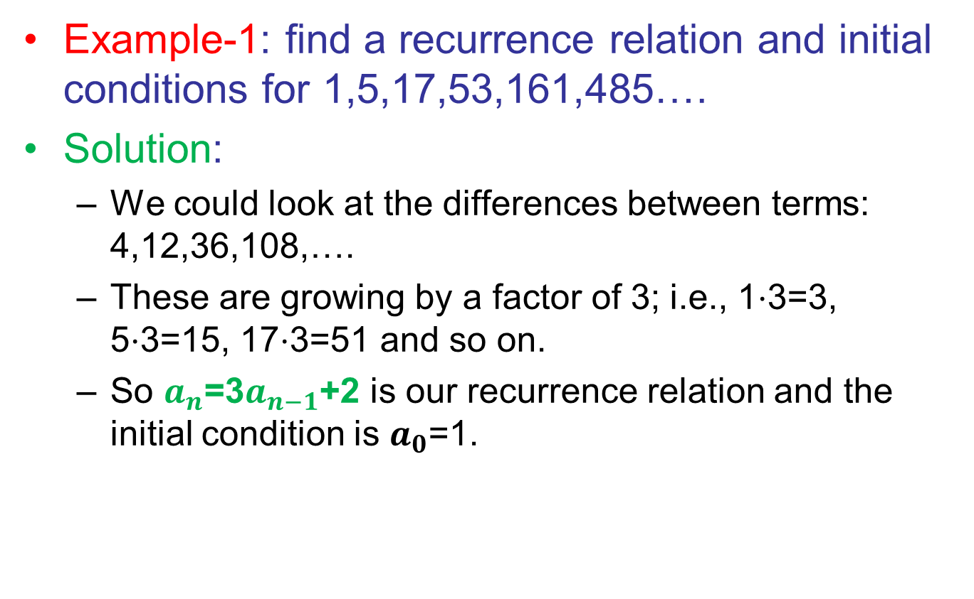
Solving Recurrence Relations (cont’d)

Slide 16
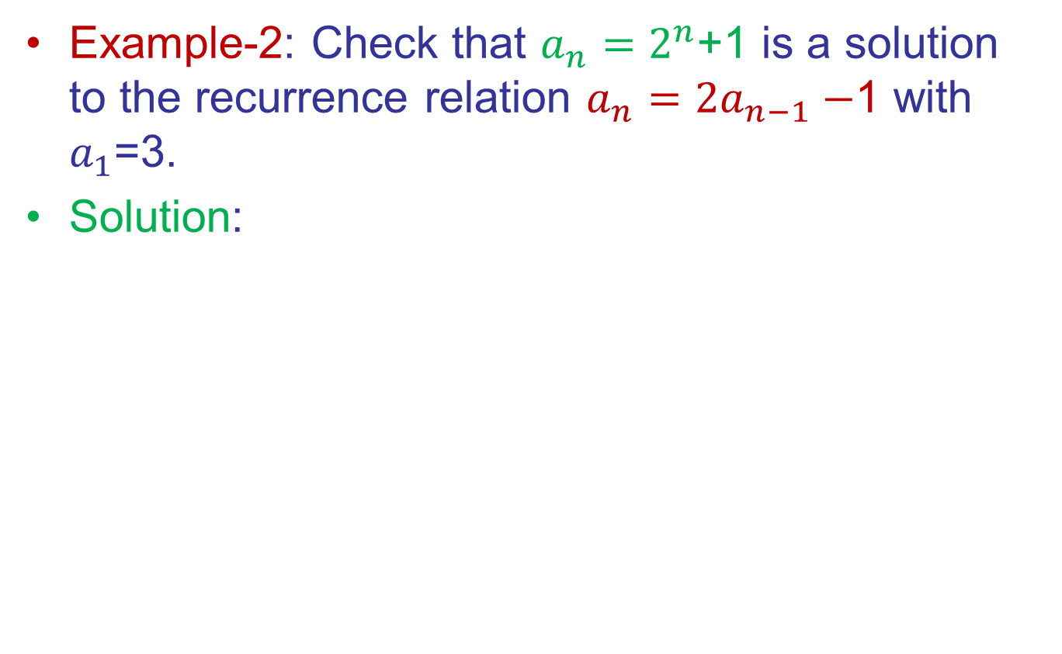
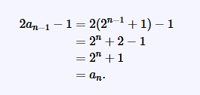
Solving Recurrence Relations (cont’d)

Slide 17
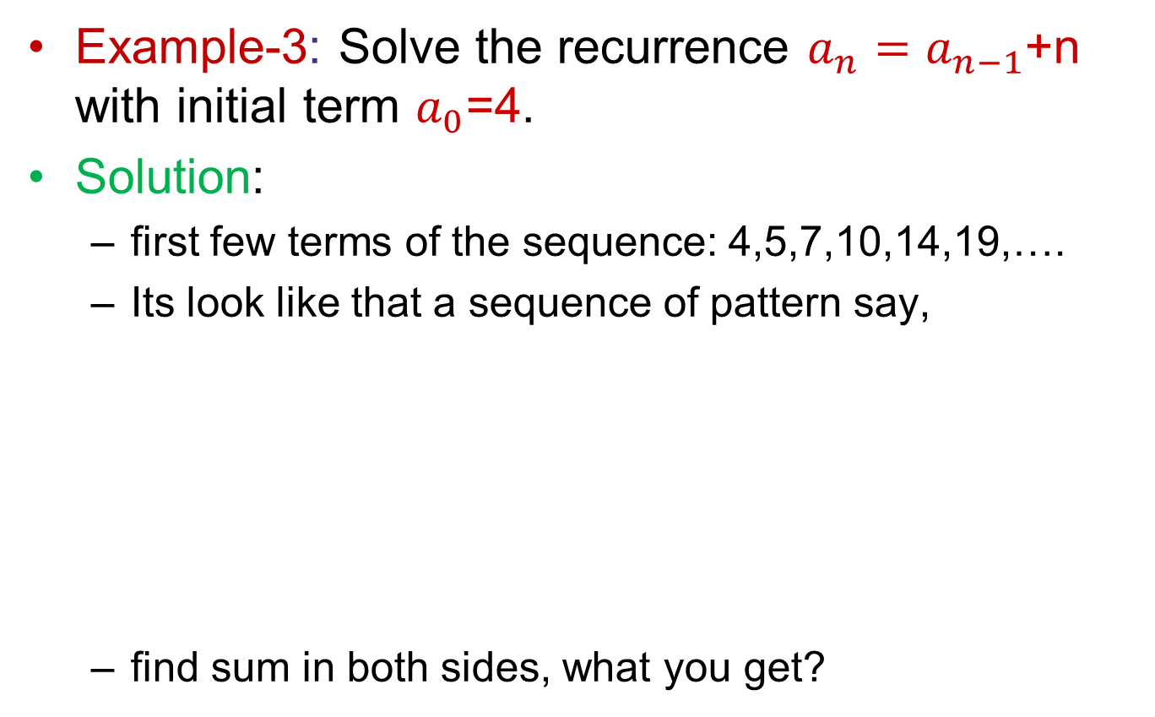
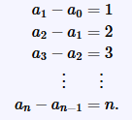
Solving Recurrence Relations (cont’d)
Notes:
(2−1)+(3−2)+(4−3)+(5-4)=-1+5

Slide 18
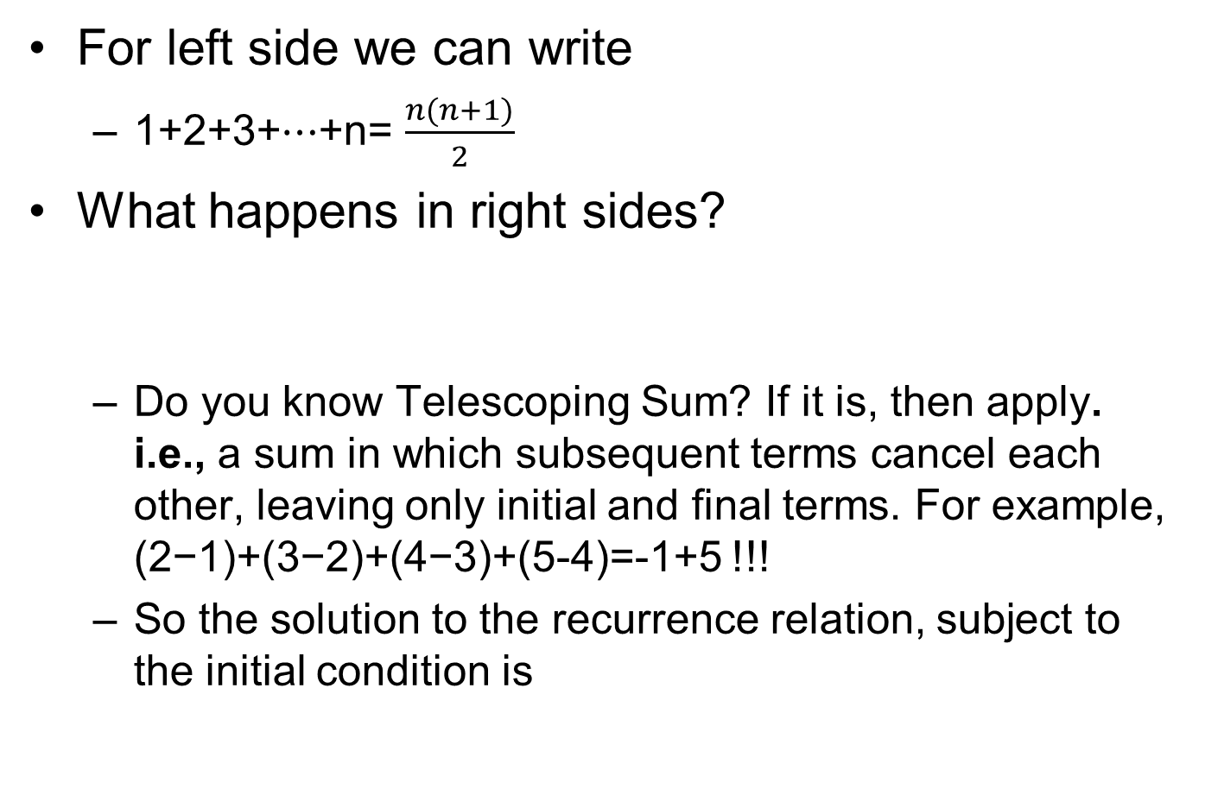

Solving Recurrence Relations (cont’d)
Notes:
(2−1)+(3−2)+(4−3)+(5-4)=-1+5

Slide 19
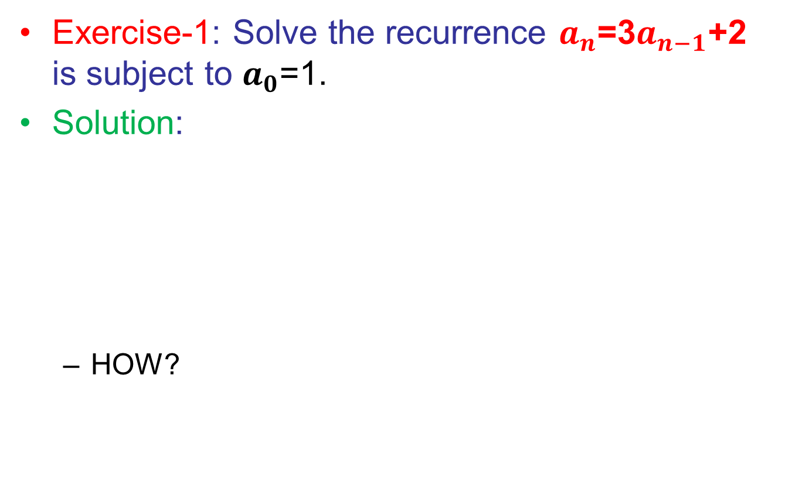

Solving Recurrence Relations (cont’d)

Slide 20
Homework
Solve the exercises from: http://discretetext.oscarlevin.com/dmoi/sec_recurrence.html (very useful reference, indeed!!!)

